Slide 1
IMS Starter
Gregor Rule

Slide 2
Objective
The overall objective of the project is the following:
To create an application with utilisation of supporting tools, methodologies and technologies that encapsulate all fundamental modules covered during training.

Slide 3
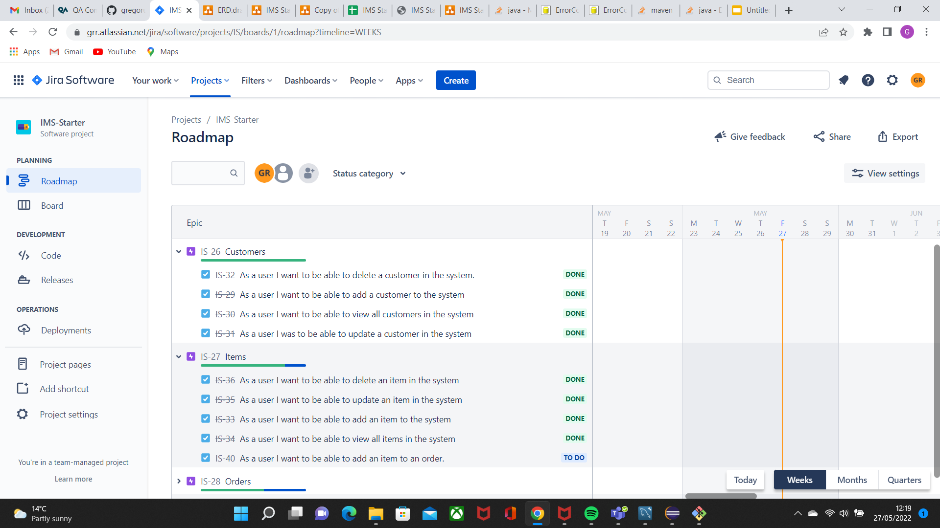
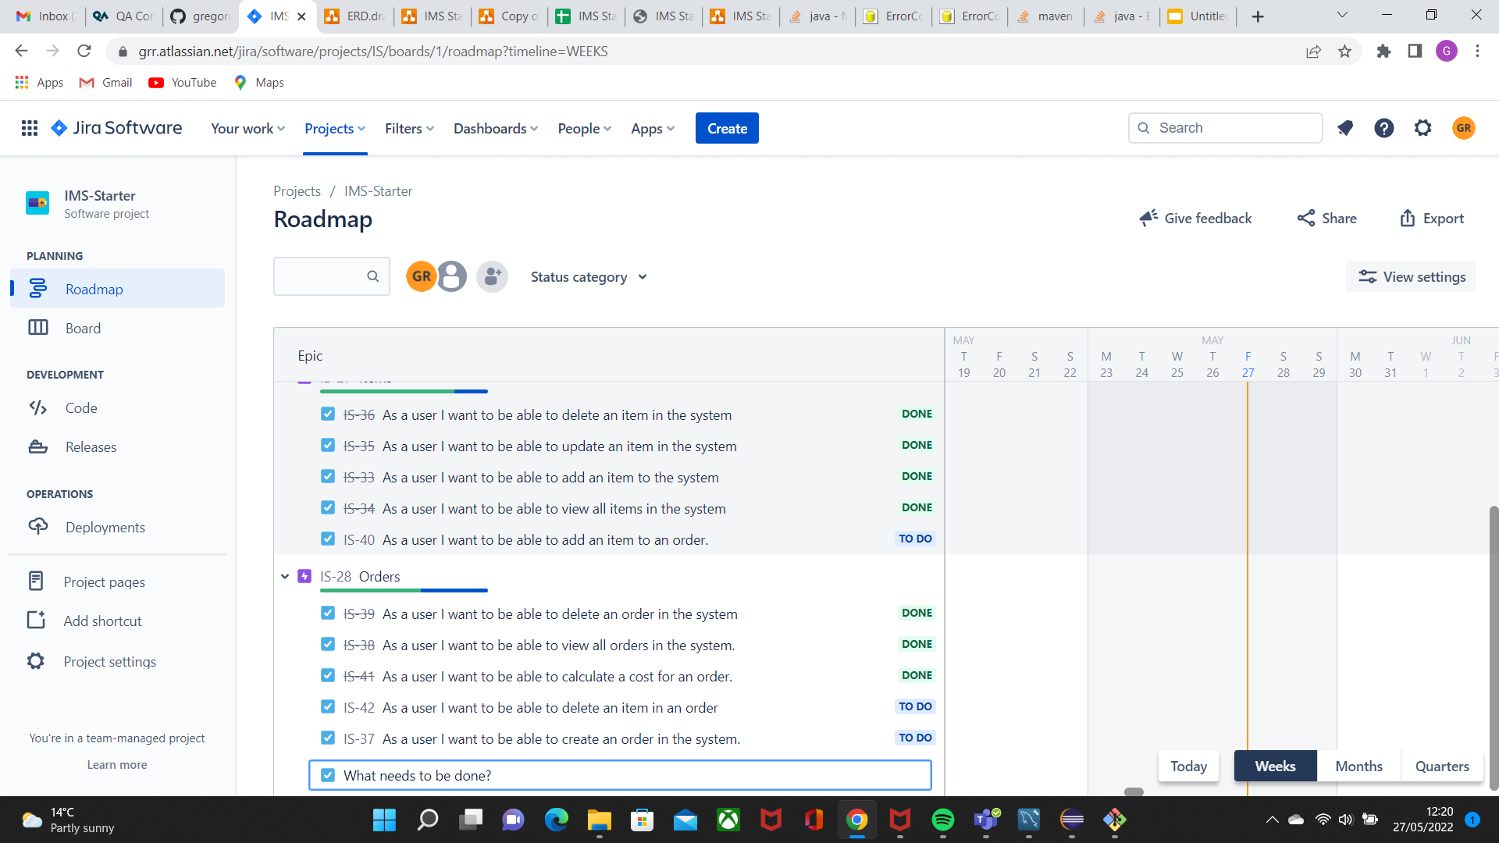
JIRA & organising

Slide 4
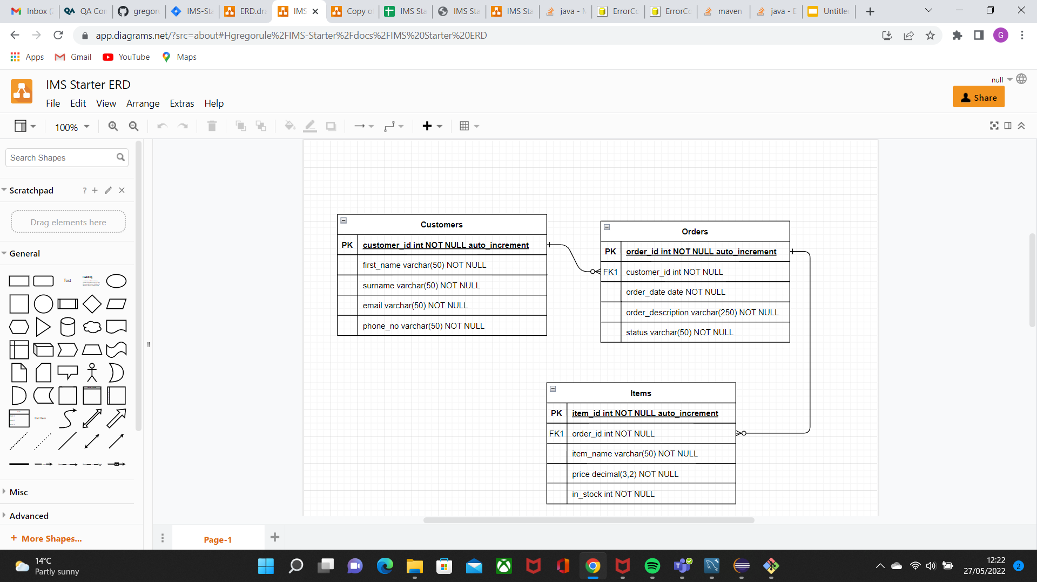
Diagrams - ERD(original)

Slide 5
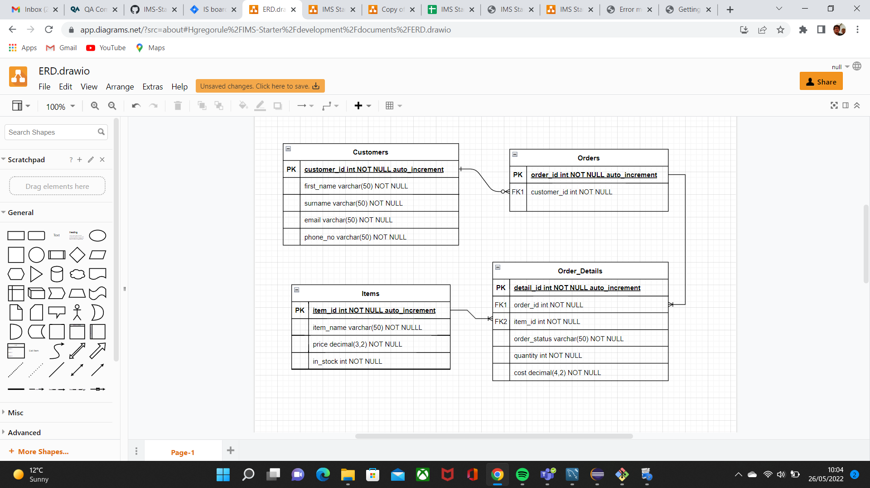
Diagrams - ERD(updated)

Slide 6
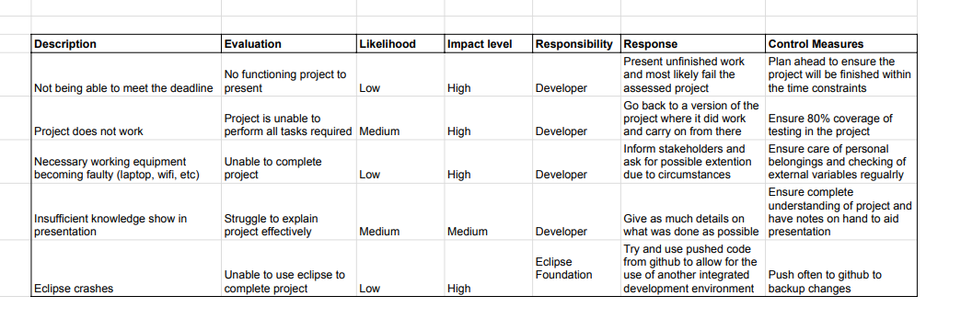
Risk Assessment

Slide 7
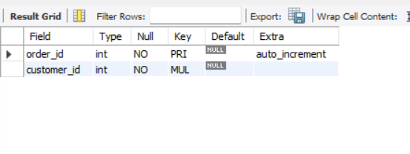
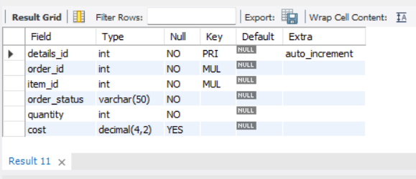
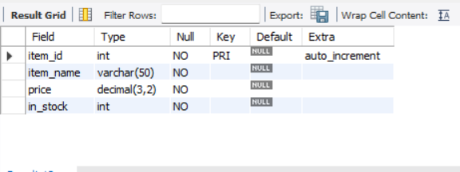
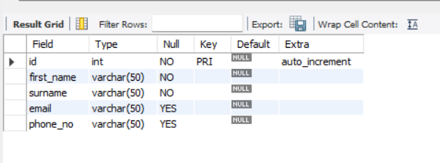
Database
orders
order_details
items
customers

Slide 8
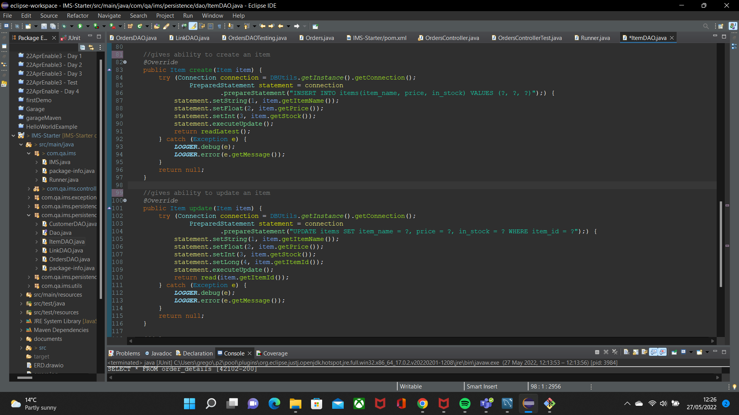
Code Screenshot
ItemDAO

Slide 9
Demo

Slide 10
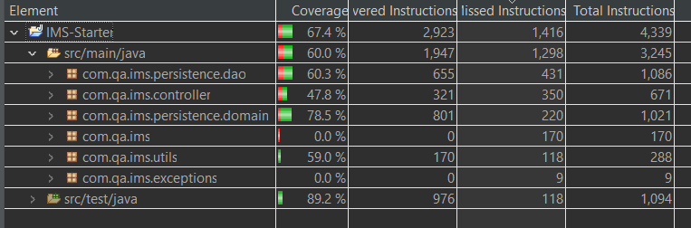
Testing

Slide 11
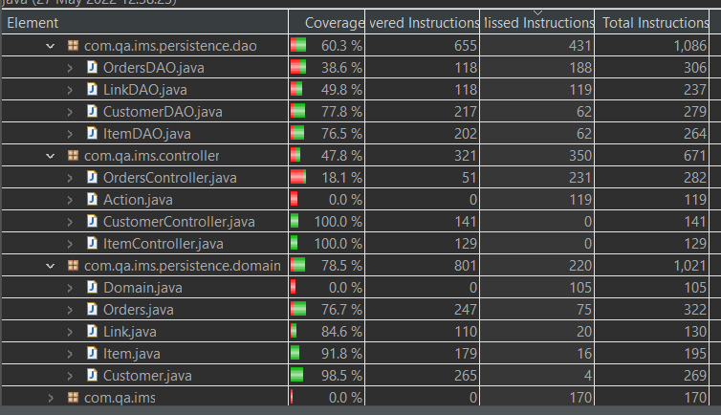
Testing Continued

Slide 12
Evaluation
What went well:
Database setup and changes
Understanding of original code
Tip of my finger tips
What didn’t go well:
Didn’t manage to meet MVP
Connection issues remain unresolved
Went down path I struggled to follow

